Slide 1
Industrial IoT Applications Using ESP32 and Modbus Protocol
Studente/i
Professore
Modulo / Codice Progetto
Alessio Tommasi
Enrico Sansonetti
Simone Vitullo
Mirko Gelsomino
TSM_IoT – Internet of things
Data
2023-2024

Slide 2
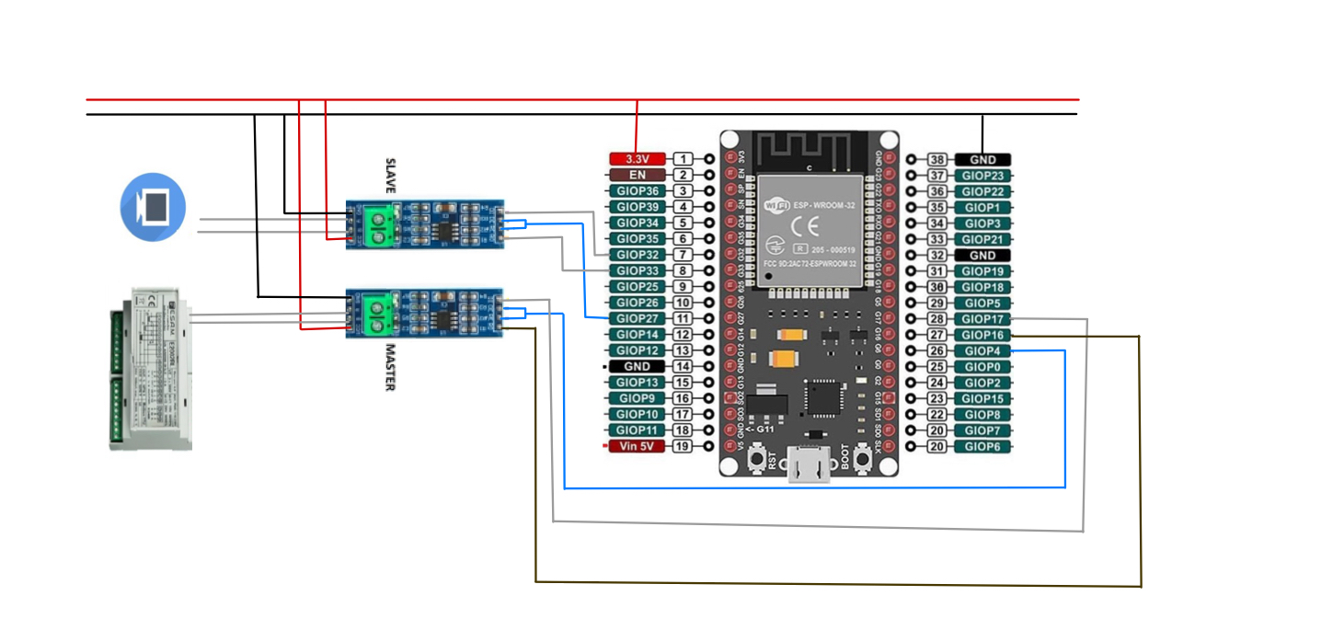
1
Introdution:
Electrical scheme
https://github.com/AlessioTommasi-supsi/iotProject

Slide 3
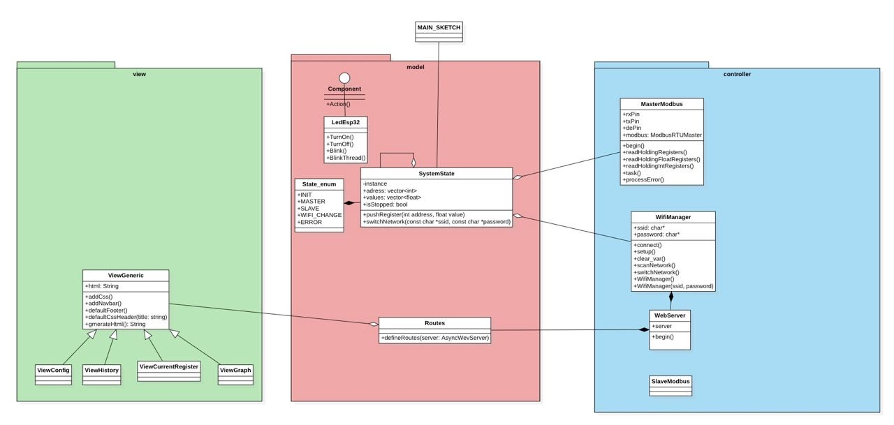
2
Introduction:
UML Diagram

Slide 4
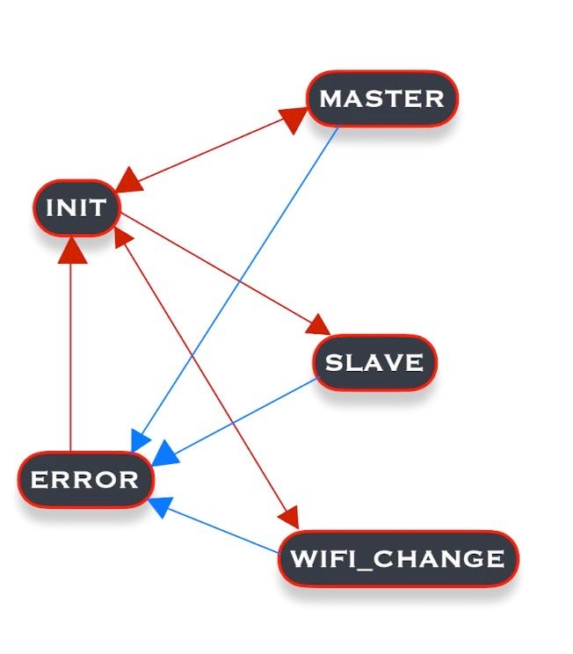
3
System State
Structured as State machine
Steady state: INIT (initialize)
Transition to sub-class
Error management
Notes:
photocatalytic degradation of reactive orange 16 (RO16) azo dye molecules dissolved in water
molecole di colorante azoico

Slide 5
4
System State
Main Function:
Push Register
Print value form specify register
Switch Network

Slide 6
5
UML Diagram
Notes:
molecole di colorante azoico

Slide 7
6
WiFiManager Class
Purpose to store the WiFi credential in the following attributes
1. ‘ssid’ Stores the SSID of the WiFi network
2. ‘password’: Stores the password of the WiFi network
Methods:
1. connect()
2. setup_AP()
3. clear_var()
4. scanNetwork()
5. switchNetwork()
6. WifiManager()
Notes:
To say: - Stores WiFi Data
- Creates the WiFi Network / Access Point as initial setup 1. connect()
2. setup_AP()
3. clear_var()
4. scanNetwork()
5. switchNetwork()
6. WifiManager()

Slide 8
7
Routes Class
Methods:
1. defineRoutes(): Method to define the endpoints for the web server.
In case a non-defined route will be called: «404 Not found».
Defined routes:
1. /history: Displays history of recorded data
2. /deleteRegister: Allows deletion of a specific register
3. /editRegister: Allows editing a specific register
4. /currentRegister: Displays current register values
5. /modbusMaster: Manages Modbus master operations
6. /storevalue: Stores a specific value
7. /getRegisterValues: Retrieves values of specified registers
8. /graph: Displays graphical representation of retrieved data
9. /config: leads you to the config page where you can switch the wifi network
Notes:
To say: /history: Displays the history of recorded data.
/deleteRegister: Allows deletion of a specific register.
/editRegister: Facilitates editing a specific register.
/currentRegister: Displays the current register values.
/modbusMaster: Manages Modbus master operations.
/storevalue: Stores a specific value.
/getRegisterValues: Retrieves values of specified registers.
/graph: Displays graphical representations of data.
/config: Configures system settings.
/switch_wifi: Switches the WiFi network.

Slide 9
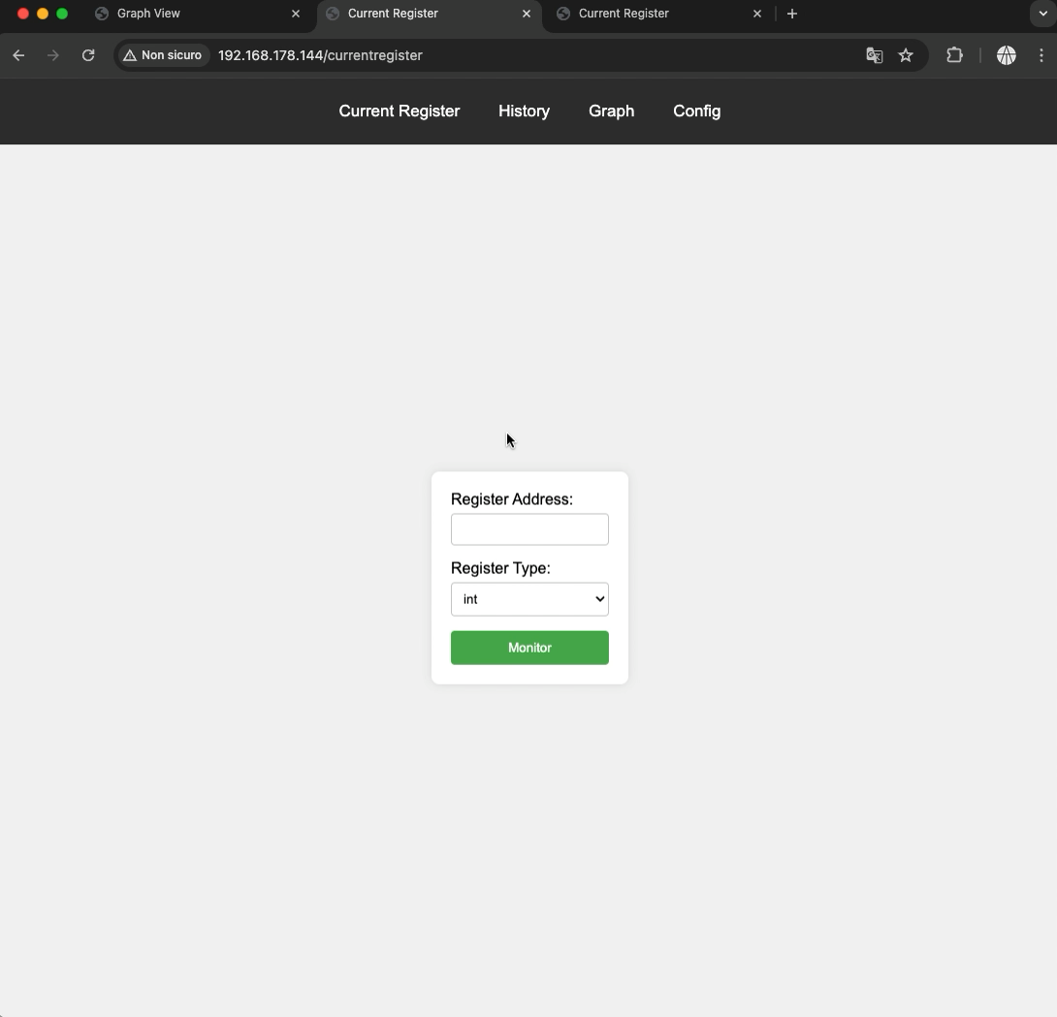
8
Small Demo

Slide 10
Thank you!
Any questions?

